Slide 1
AI Plus Team 1
Project Demo
By: Daniel Hou, Sophia Hou, Victoria Xiong, Sarah Du, Jessica Du, and Shauna Lyu

Slide 2
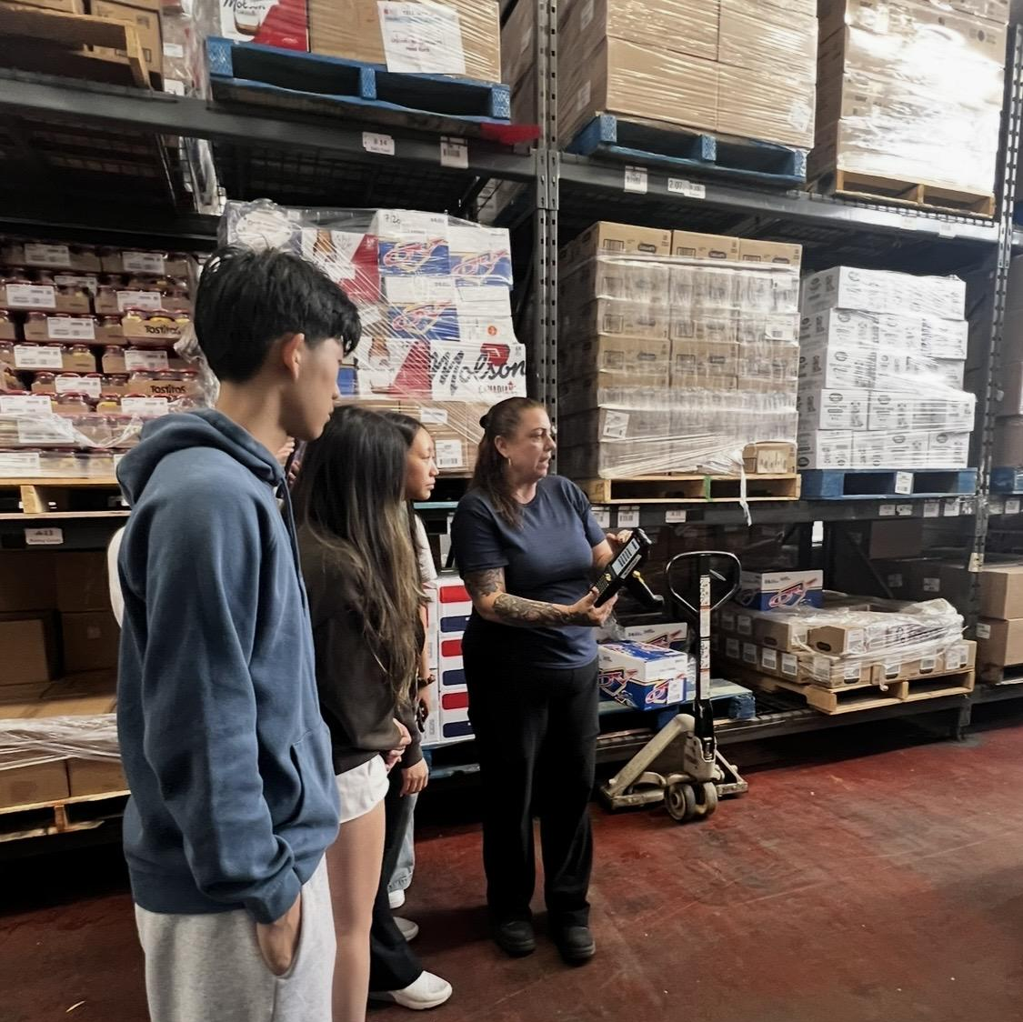
01
Last time…

Slide 3

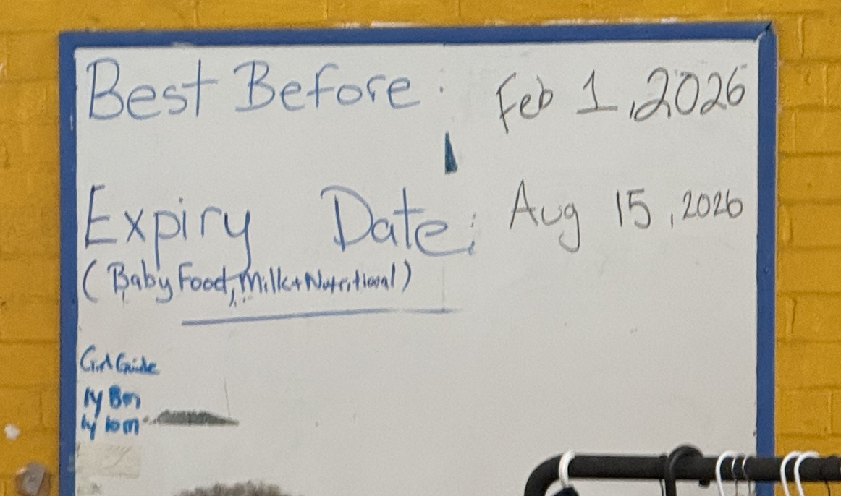
Recap
Identified a large gap with the food bank:
Large amount of food being wasted
Information to be disorganized
Notes:
#shebecamebuff

Slide 4
The Current System
Primarius is the software that North York Harvest uses to help organize their inventory
Expiration dates are not automatically stored
Staff manually checking packaging
Prove to become an even bigger problem as they move to a larger facility

Slide 5
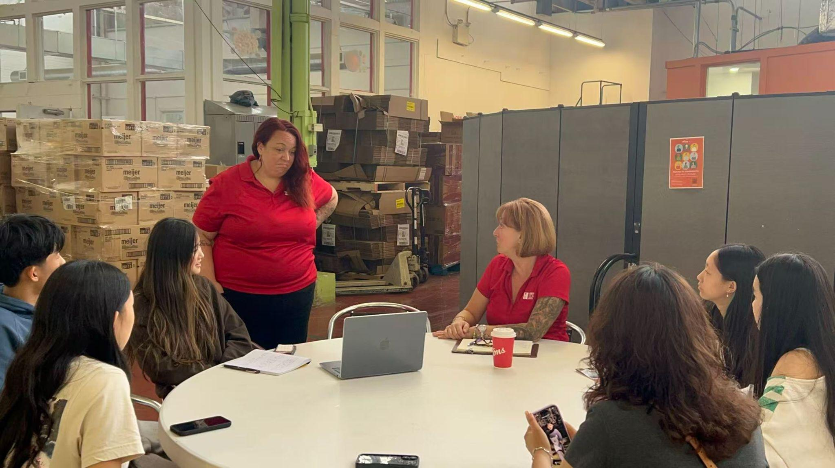
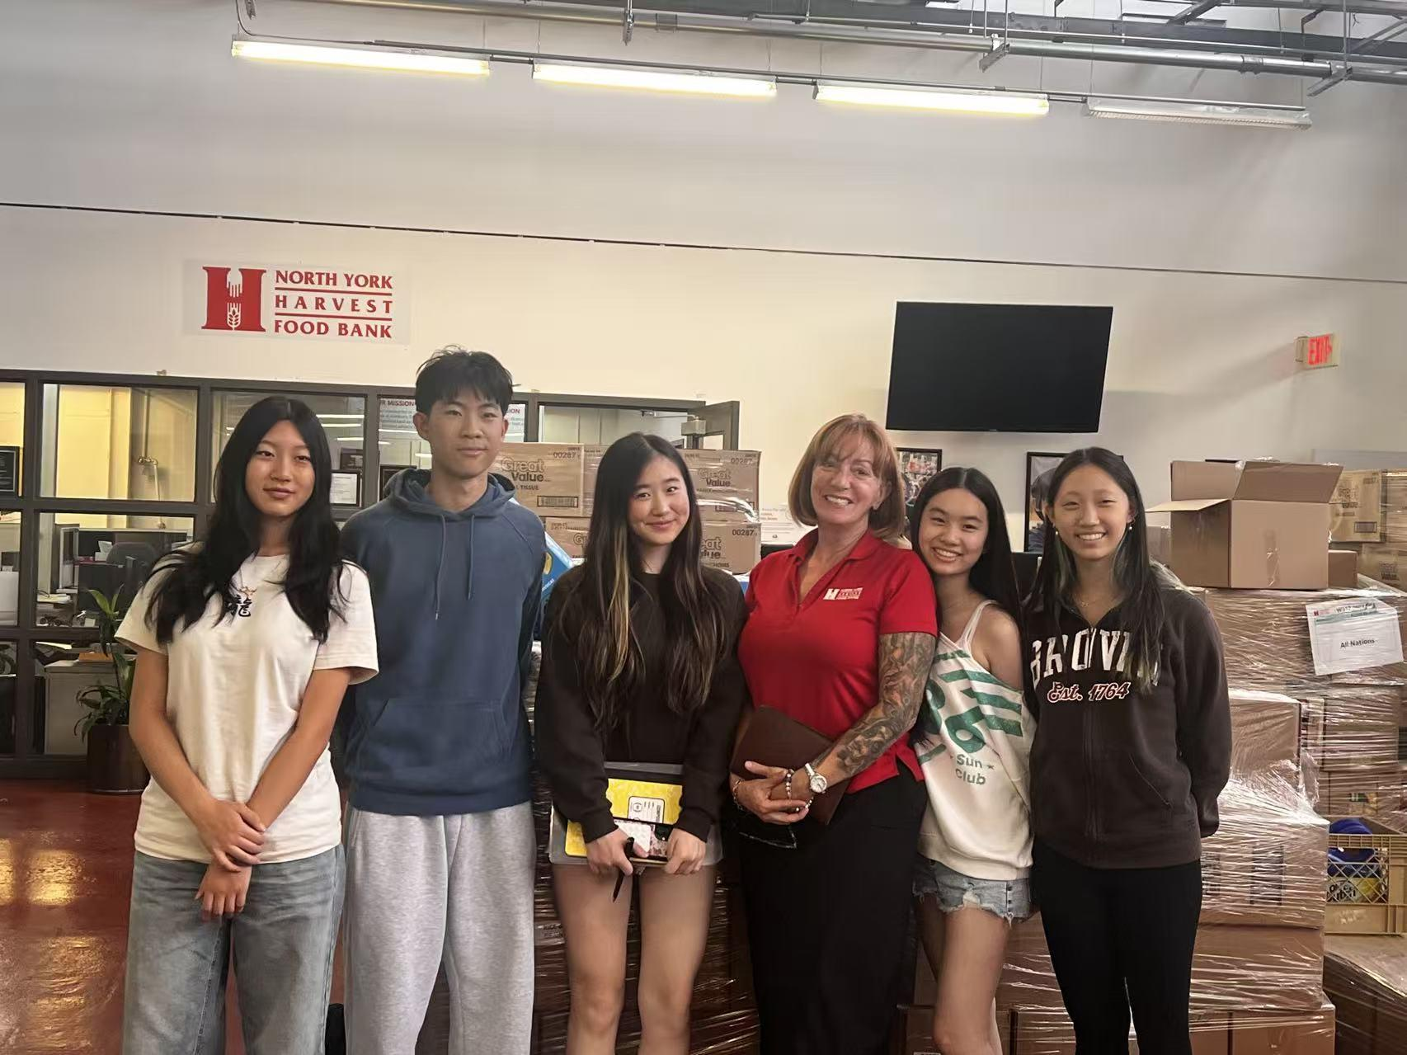
The Experience (Part 2)

Slide 6
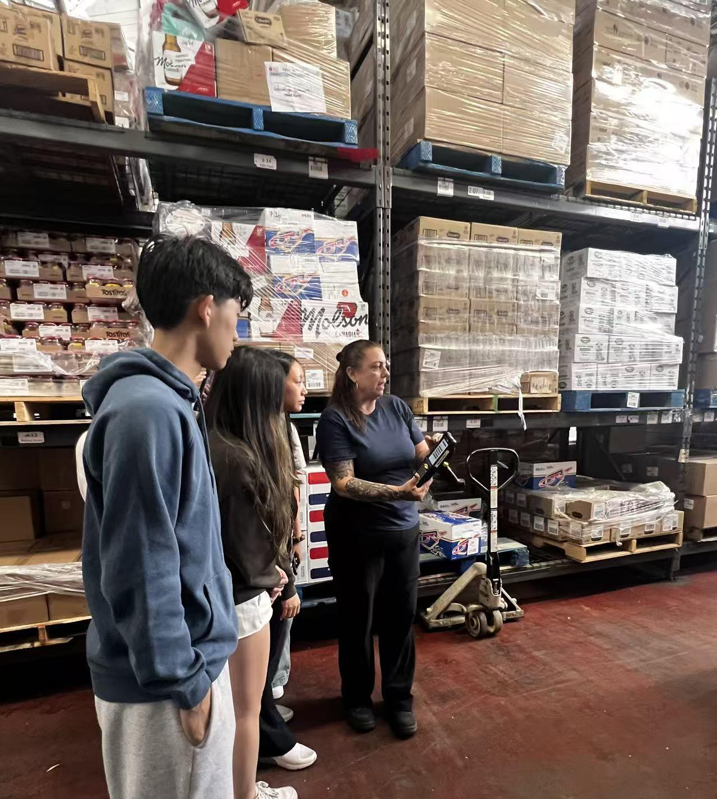
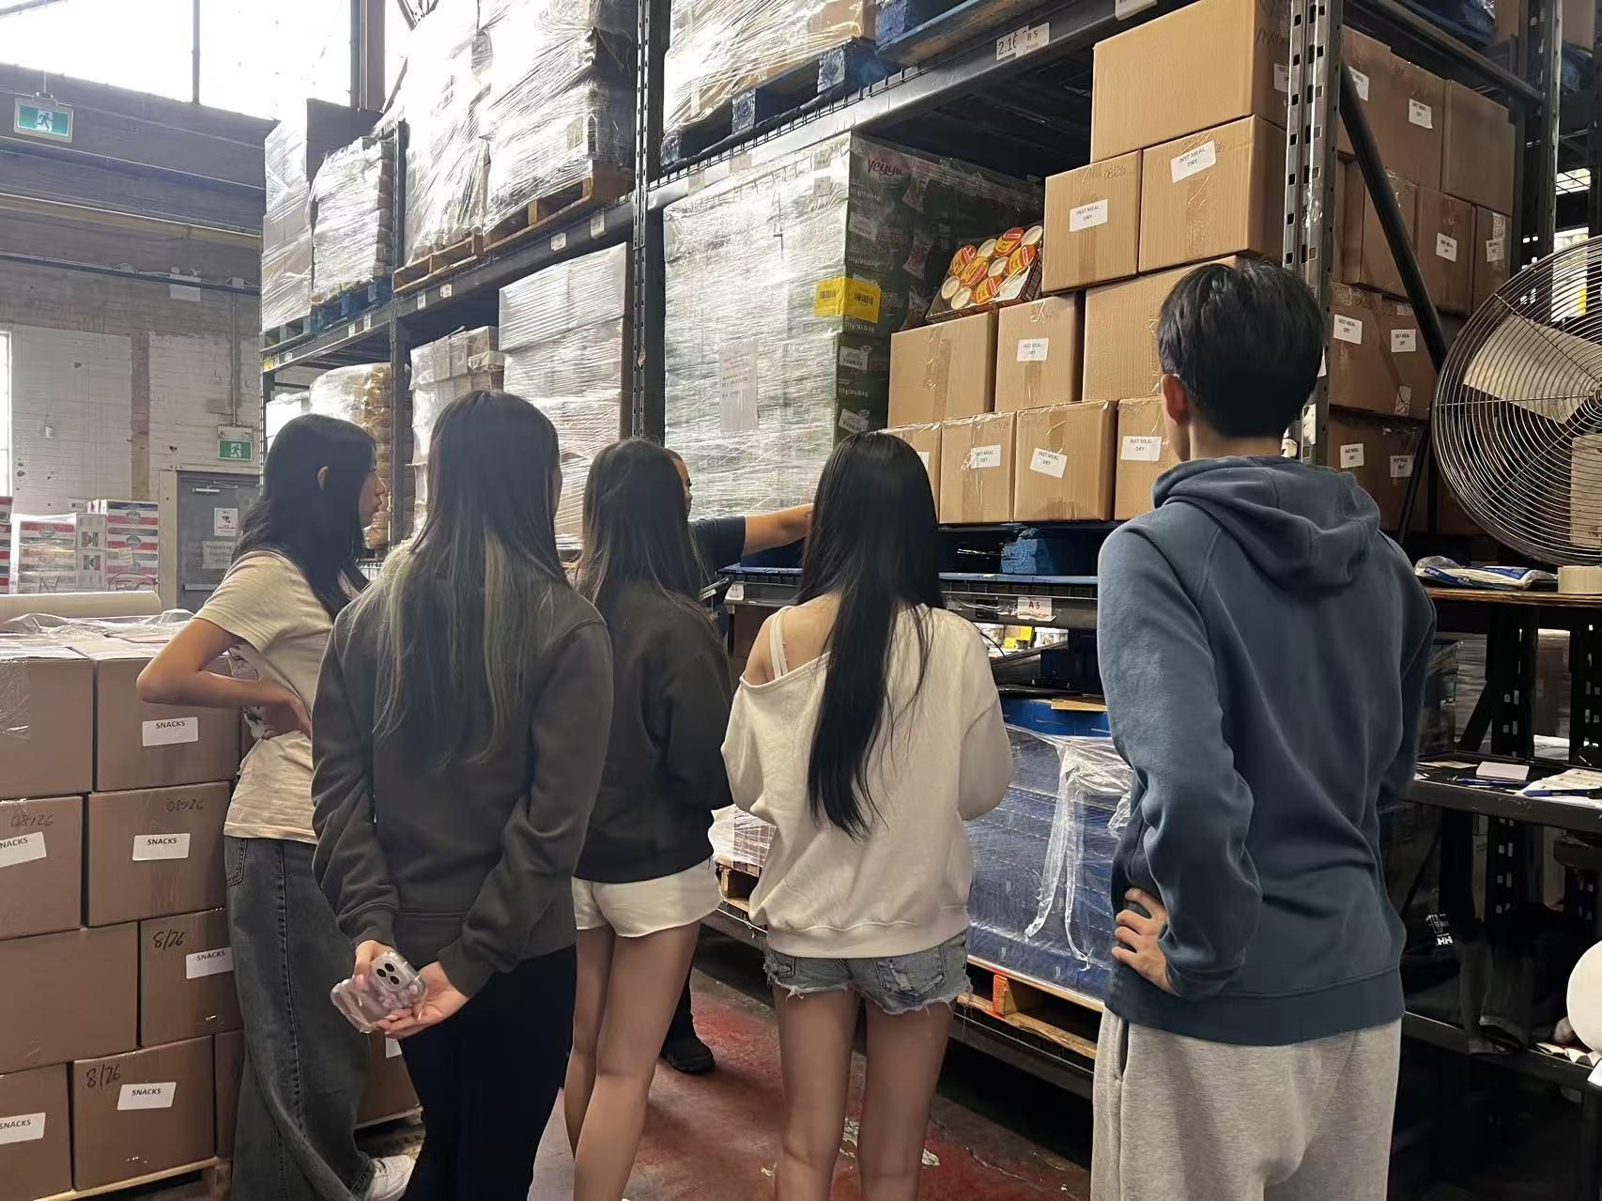
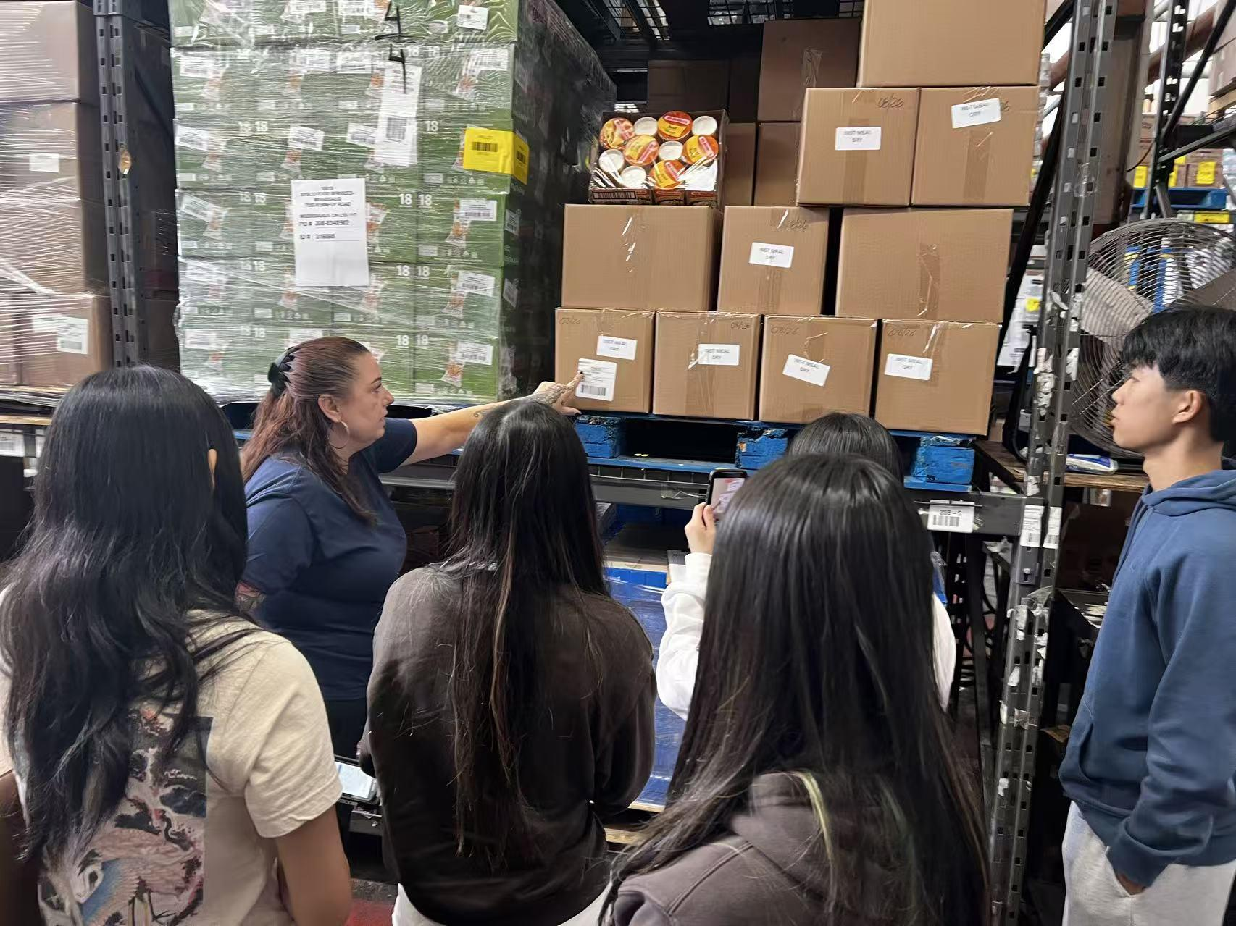
The Experience (Part 2)

Slide 7
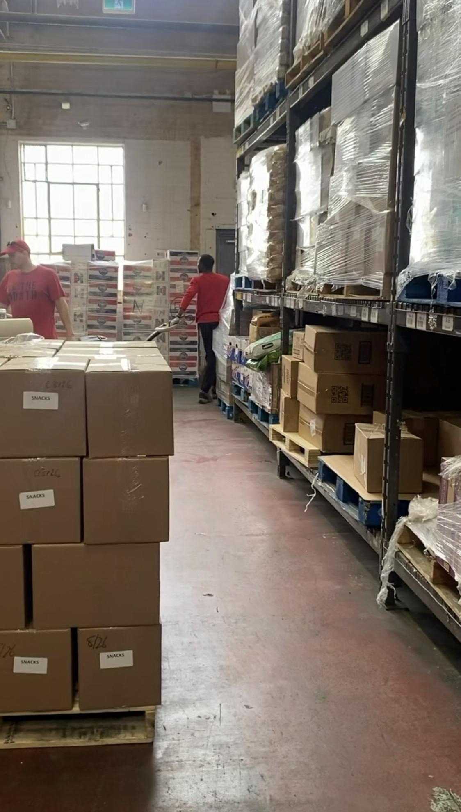
02
Our product

Slide 8
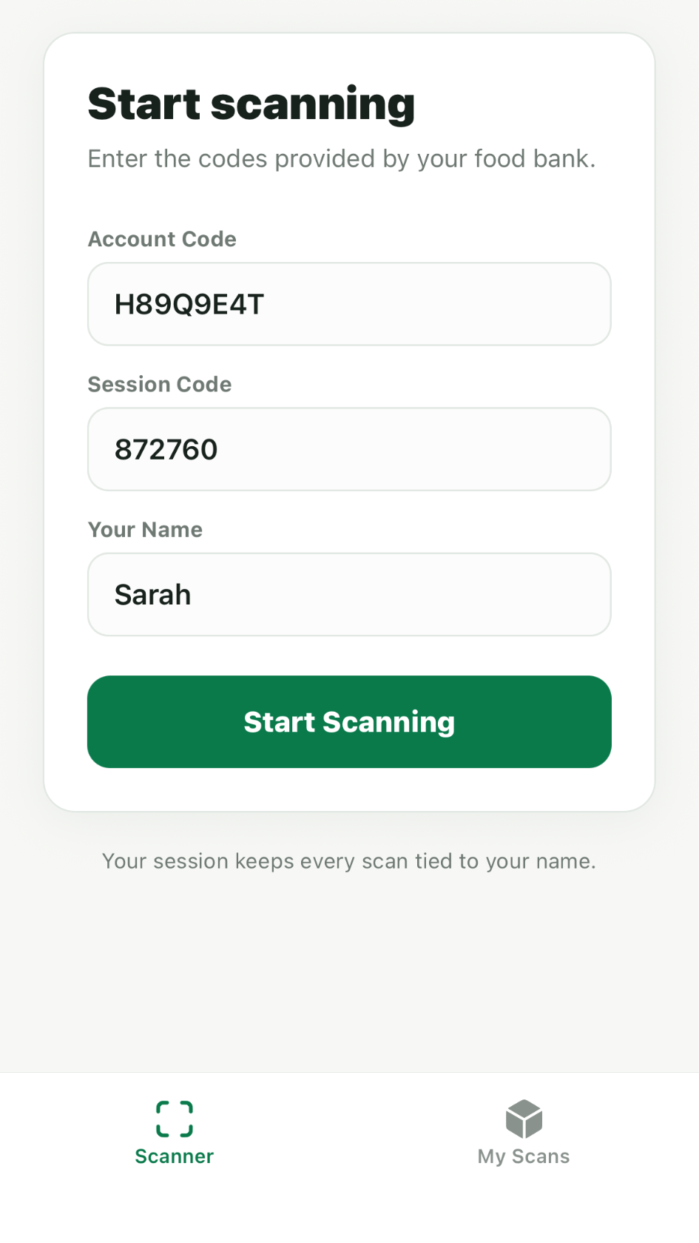
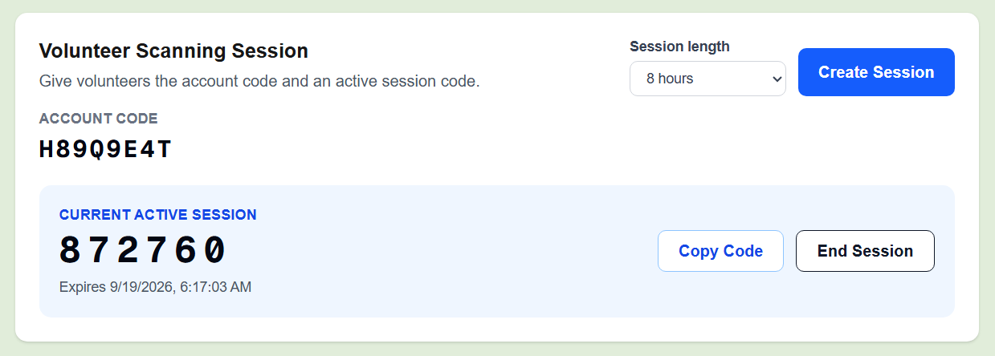
Volunteer Login
Volunteer’s Mobile Device

Slide 9
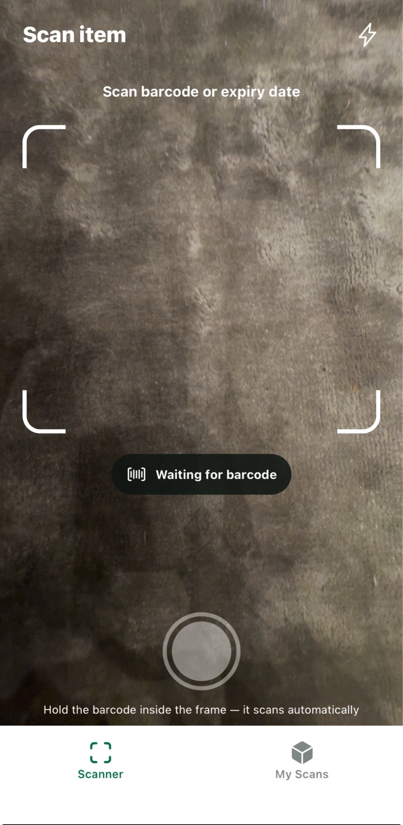
Scan a product’s barcode or expiry date
View a personal history of all items scanned by each volunteer.

Slide 10
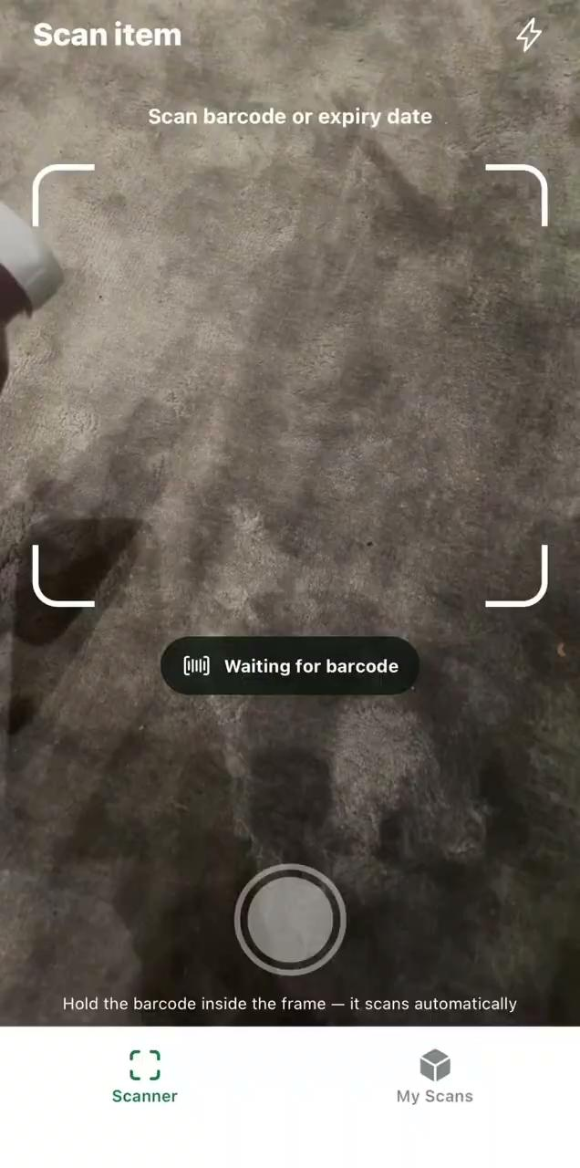
Scan & Review

Slide 11
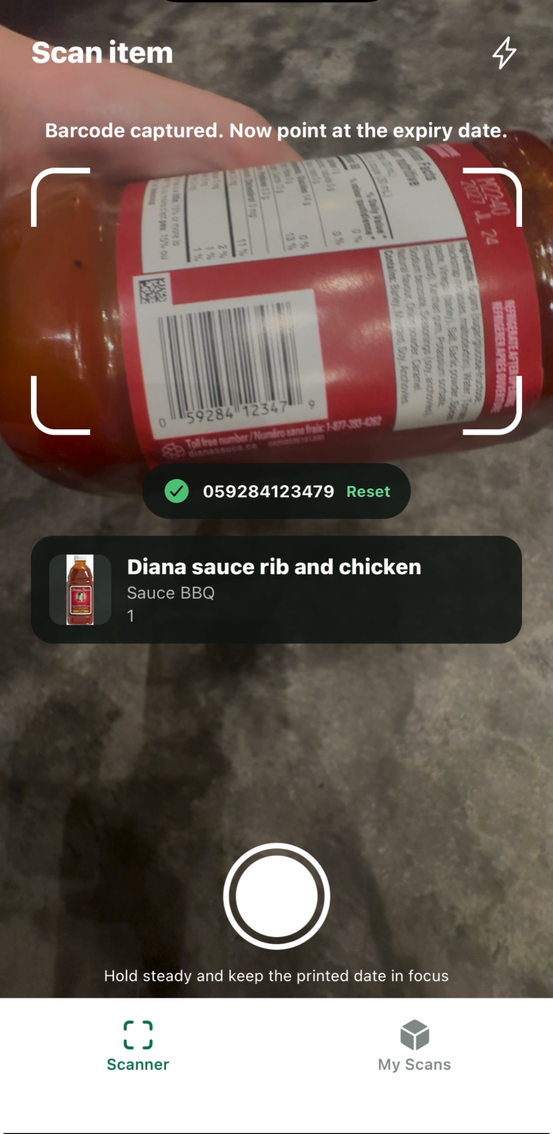
Scan Barcode
System automatically reads + extracts the expiry date and expiry date type.

Slide 12
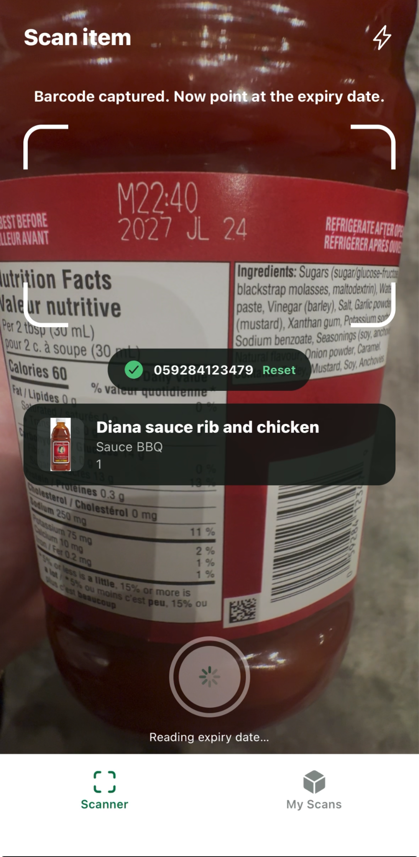
Scan Expiry Date
System extracts barcode number and product information

Slide 13
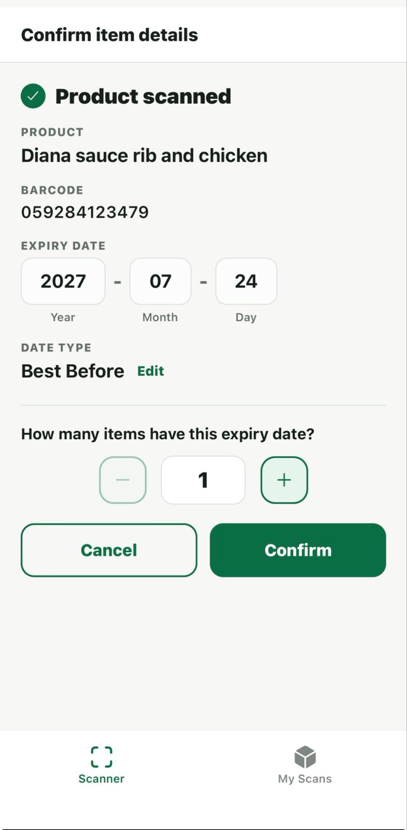


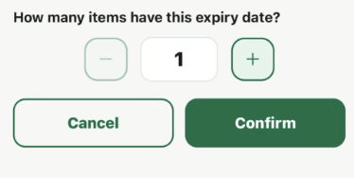
Review + Edit Information
Expiry Date
Expiry Date Type
Quantity
Confirm + Save

Slide 14


Personal Volunteer Scan History

Slide 15
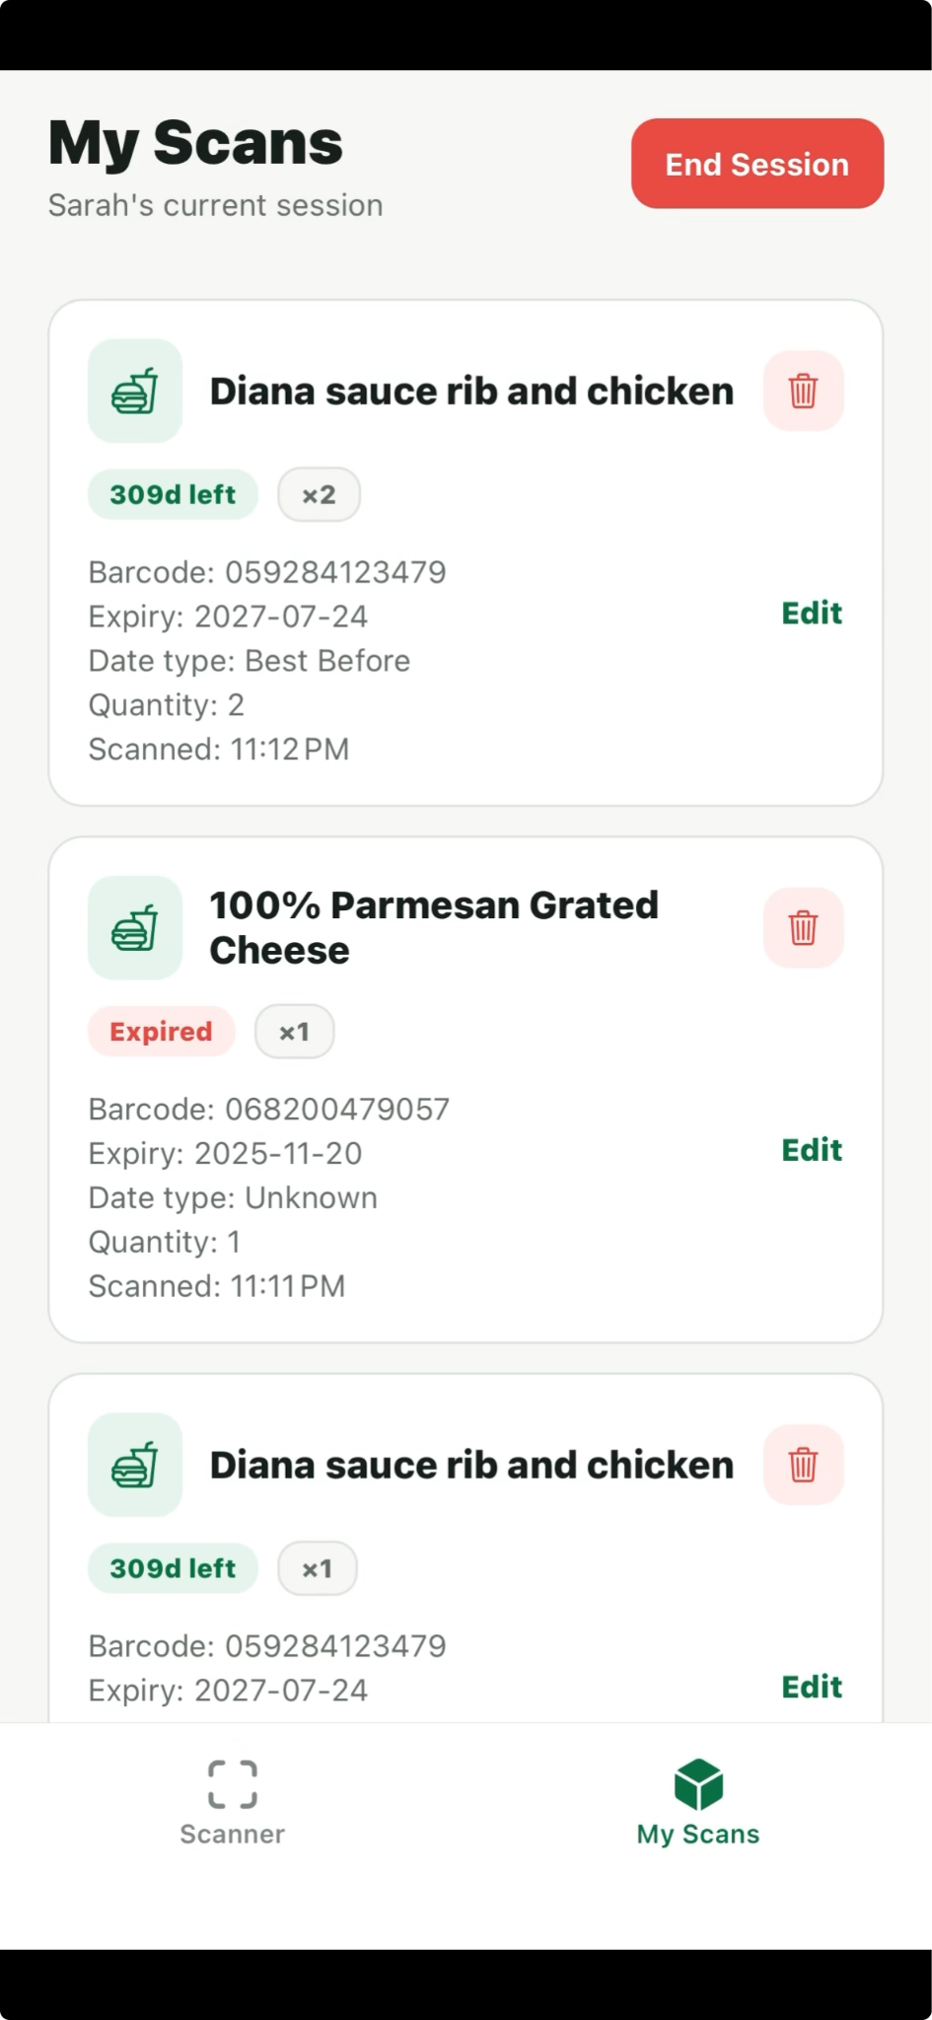
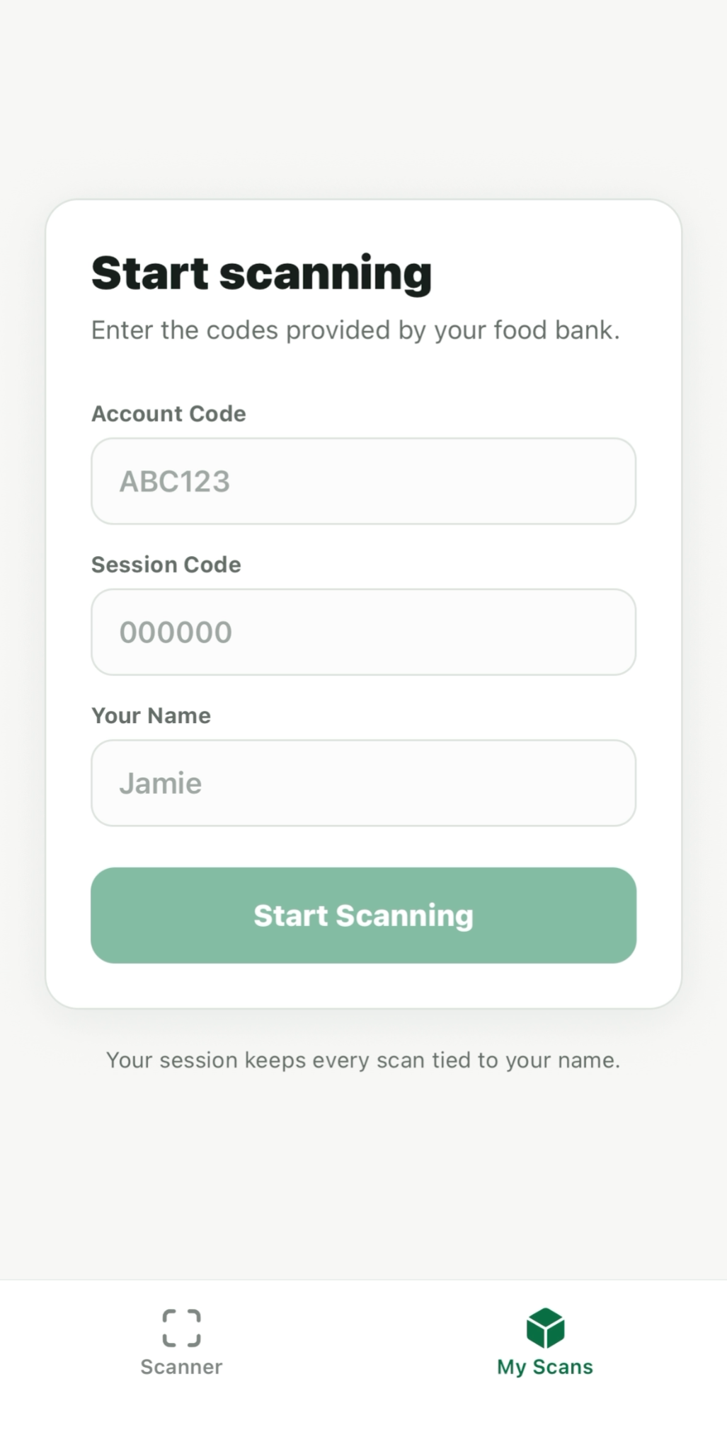
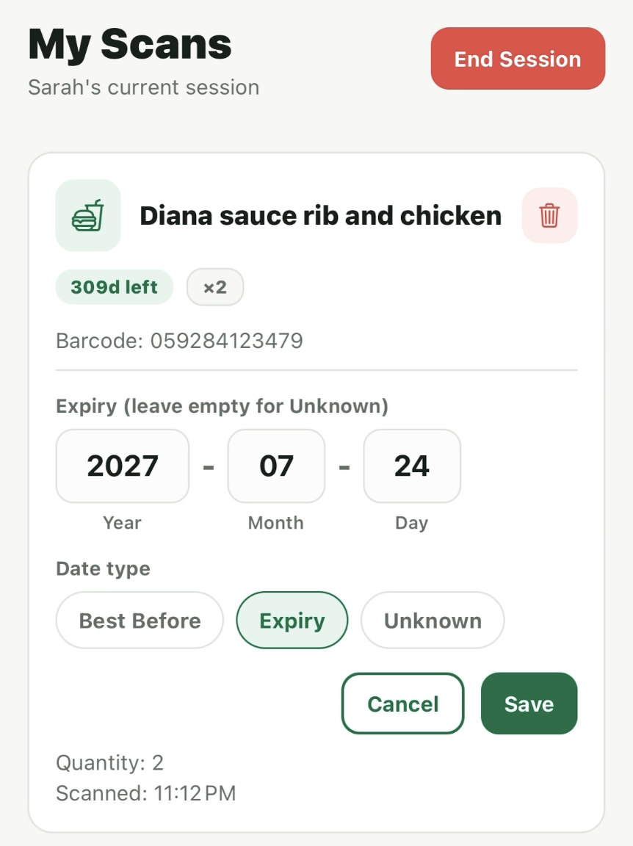
My Scan

Slide 16
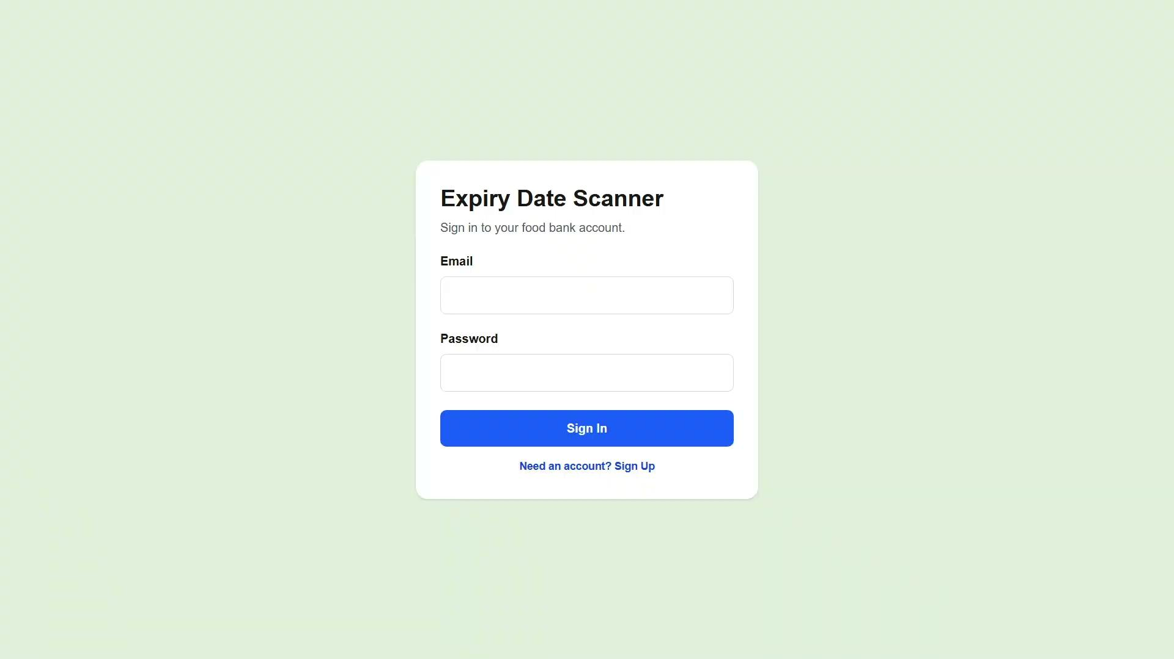
Database Website

Slide 17
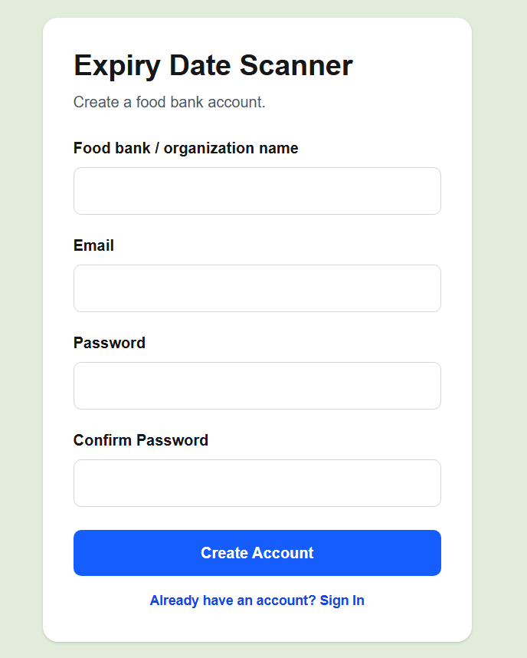
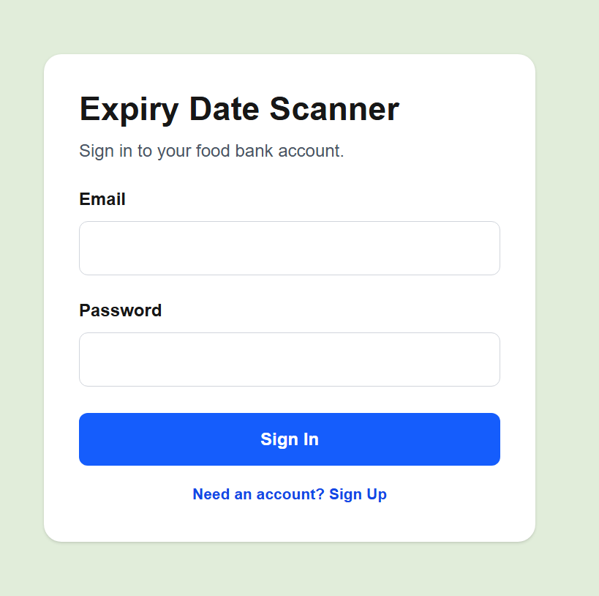
Administrator Sign-In
Sign in with food bank administrator credentials, or create an account.
General Food Bank
Login Information

Slide 18
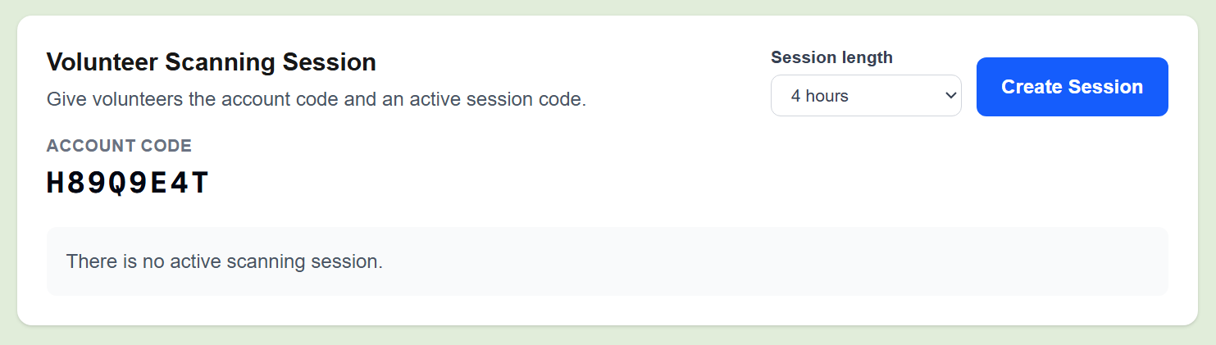
Sessions
Scanning sessions come with the purpose of ensuring security in the database.
Administrators can create set-duration sessions for volunteers granting temporary access

Slide 19
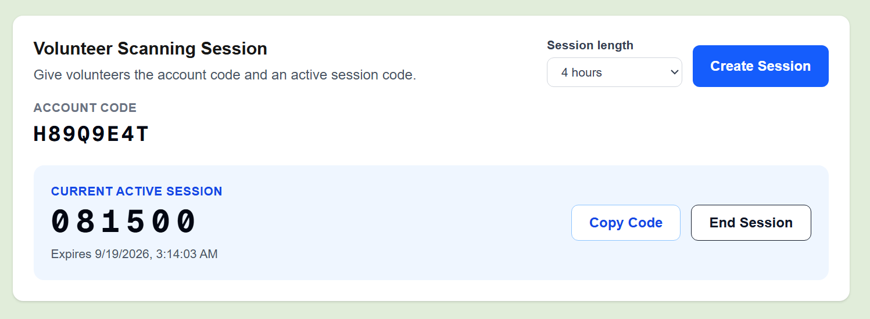
Sessions
Volunteer Code

Slide 20
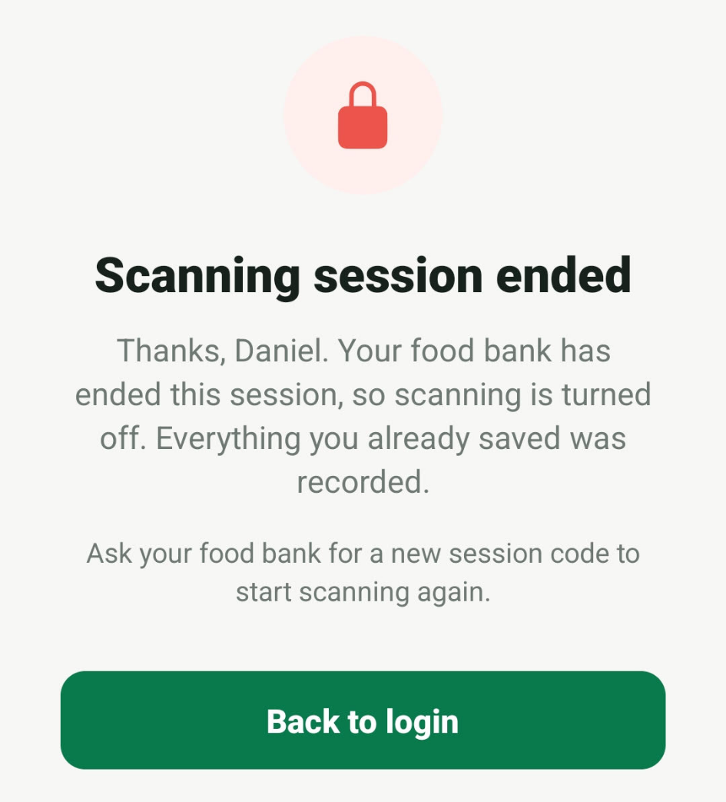
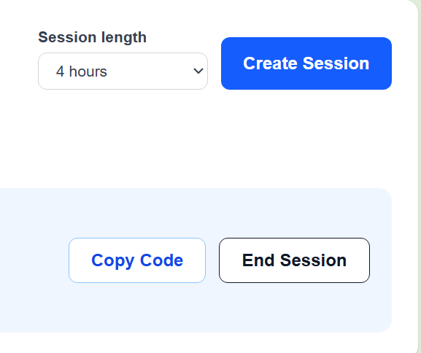
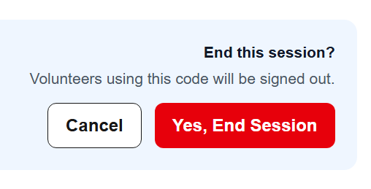
Sessions
If needed, sessions can be ended early, which will boot all volunteers out of their mobile apps.
Confirm Button
Mobile view after termination

Slide 21
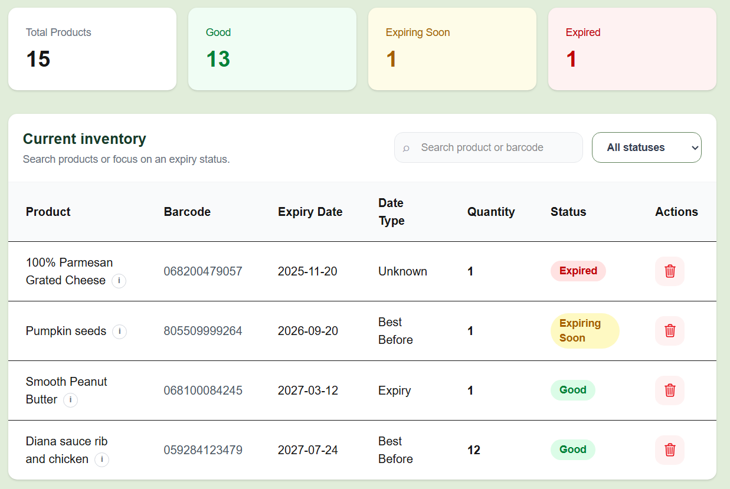
Product Viewing
All information stored in a backend database are displayed
Status counts
Filters
Search Bar
Delete Button

Slide 22
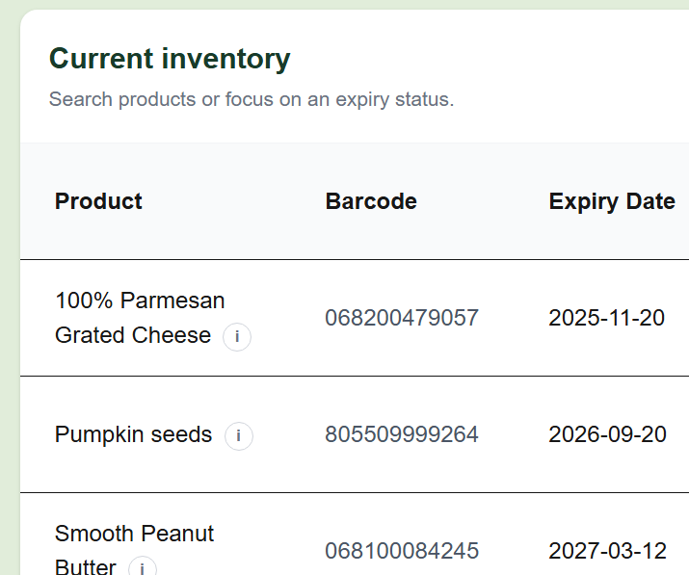
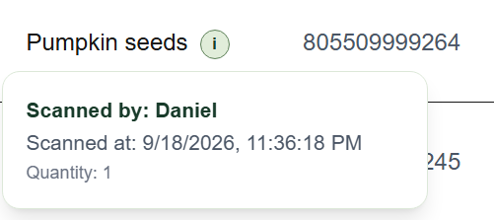
Product Viewing
For security purposes, all products tracked include the names of the volunteers that scanned them, along with the date and time of scan.

Slide 23
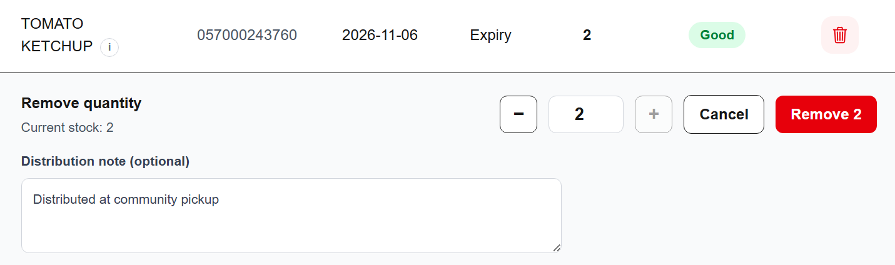
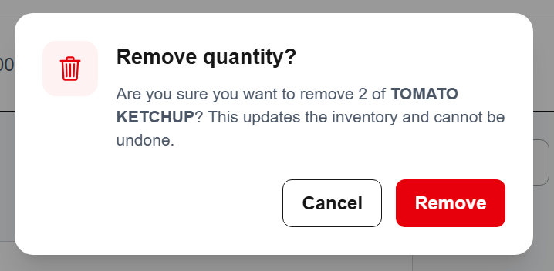
Removing Products
Clicking the delete button will open a display below
Enter a reason for removal
Confirmation Screen

Slide 24
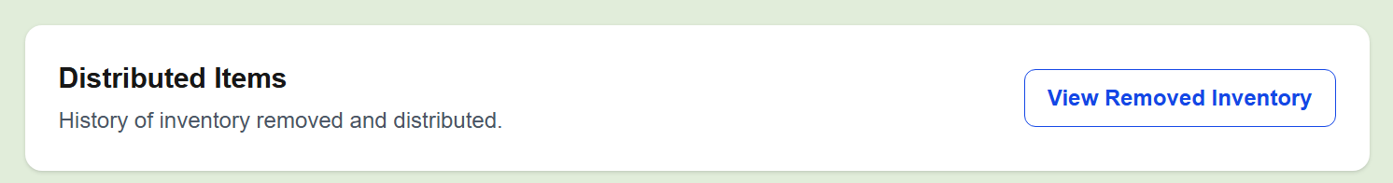
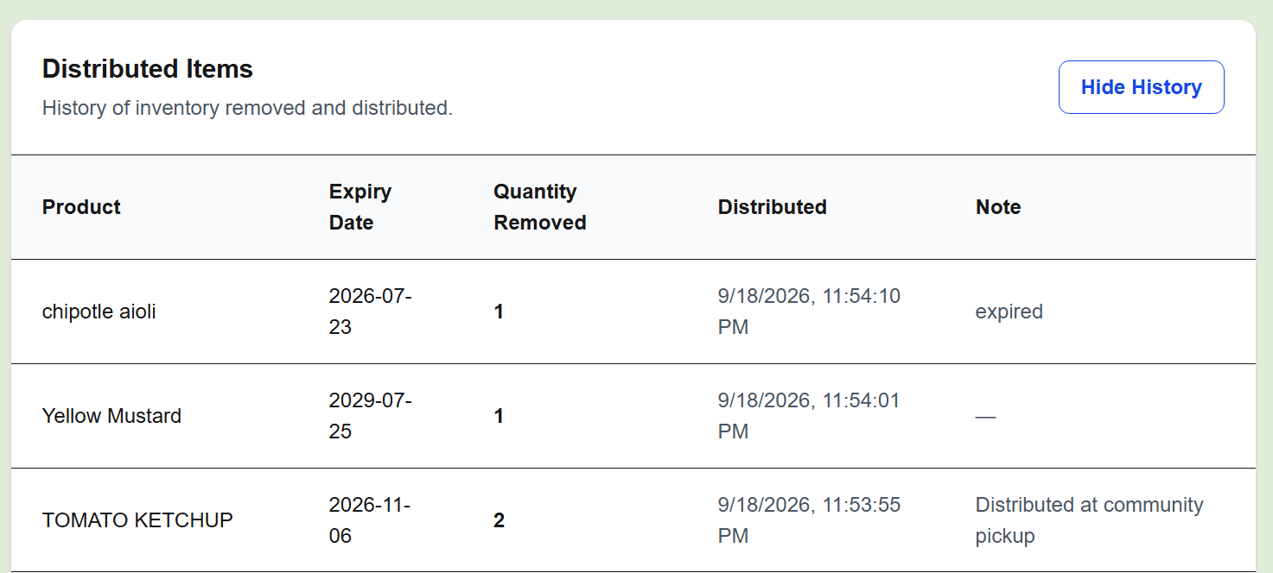
Distributed/Removed List

Slide 25
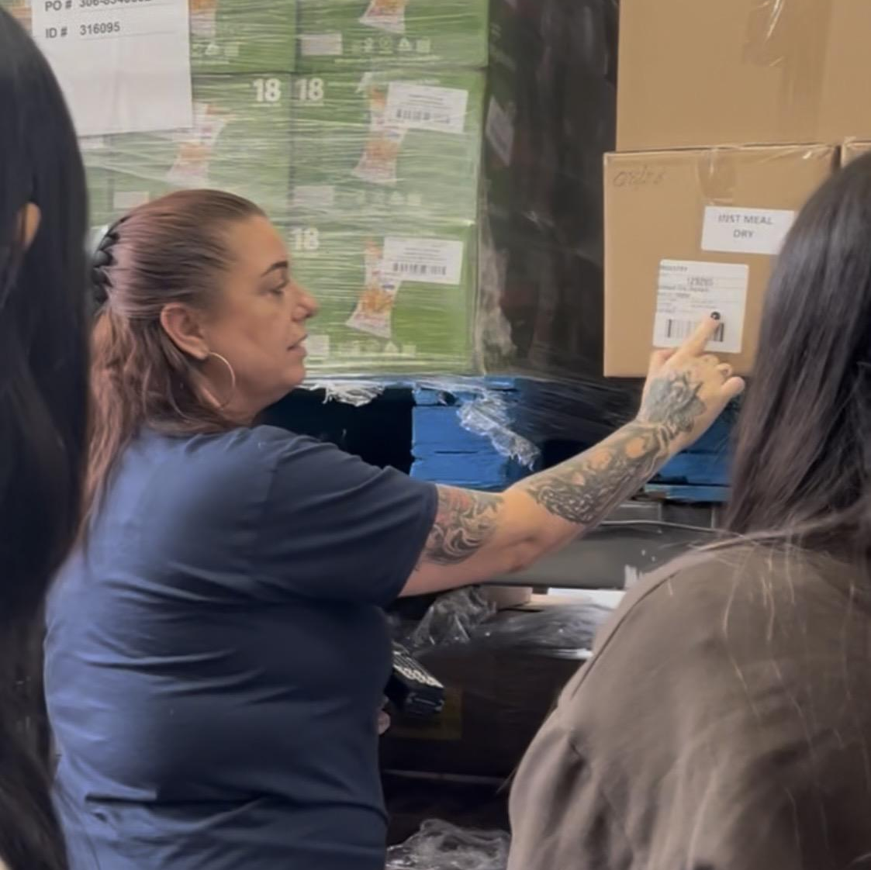
03
Design Process

Slide 26
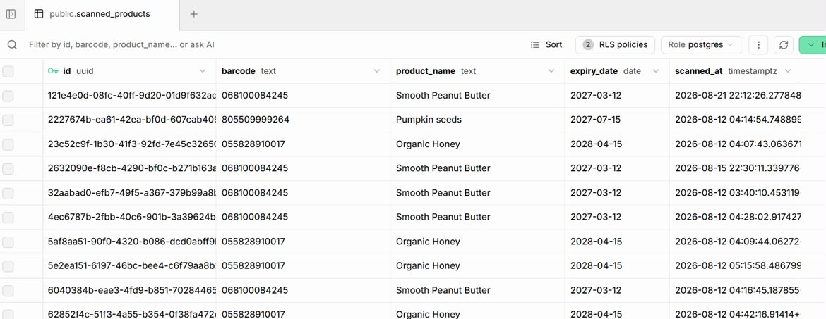
Design Process
Initial foundation for the project was clunky and difficult to navigate
OUR JOB: make the mobile app and database as efficient and aesthetically pleasing as possible
The initial database prior to any redesigning (boring)
Notes:
Once we created the initial foundational code for our project, although it was functional, it was clunky and difficult to navigate
OUR JOB: make the mobile app and database as efficient and aesthetically pleasing as possible

Slide 27
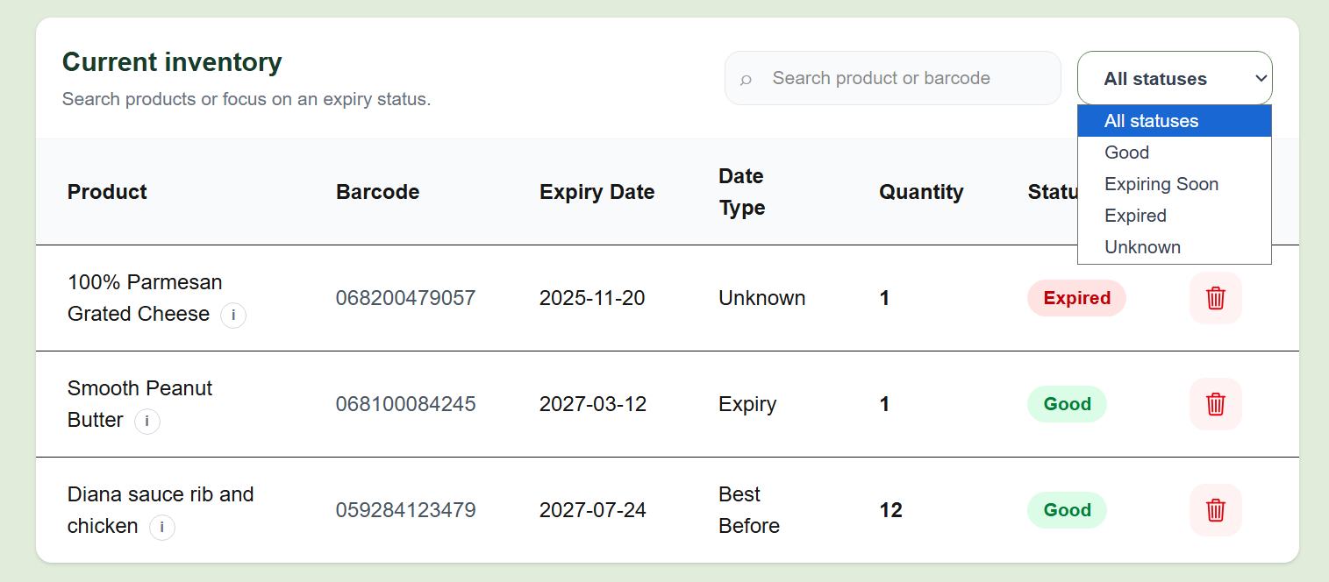
Design Process
WHAT WE ADDED:
Visuals
Stayed consistent with the green and white color scheme (mobile & web)
Added search bar (web)
Allows users to look up products or barcodes
Added filters (web)
Allows staff to easily identify products that are expiring soon, expired or good
The database after redesigning and new features
Notes:
s

Slide 28
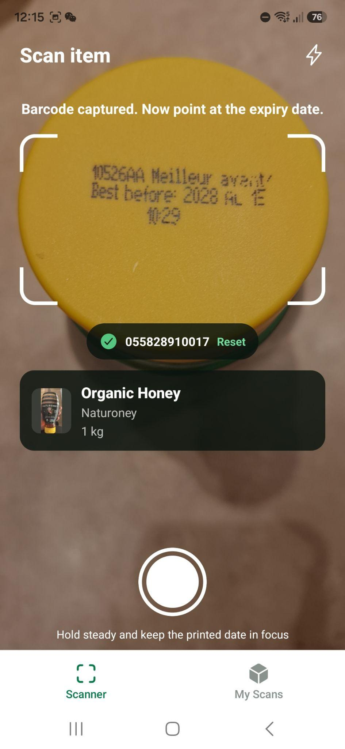
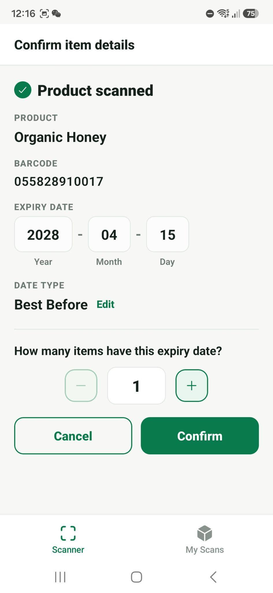
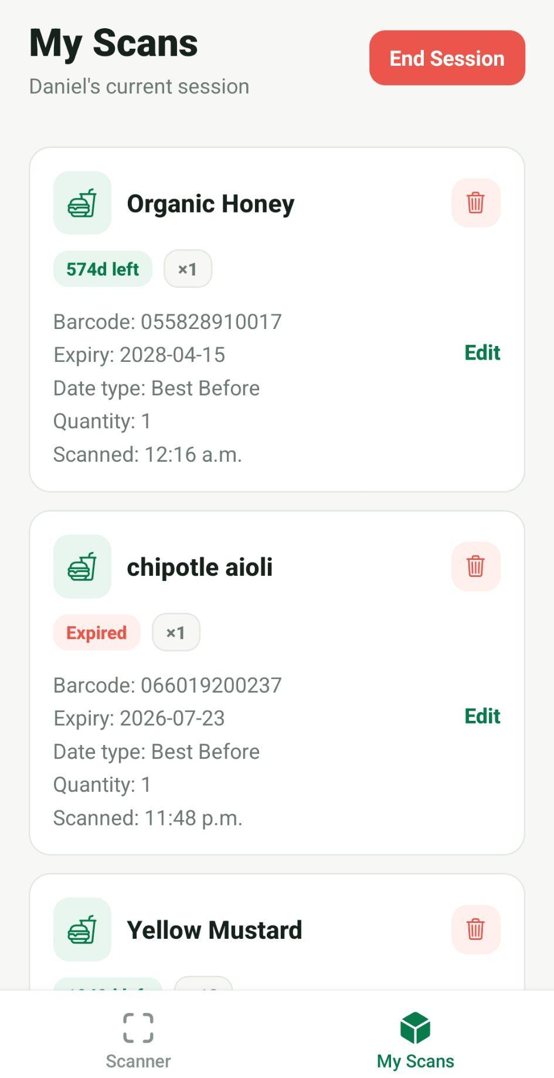
Design Process
WHAT WE ADDED:
Camera (mobile)
Scanner corners, capture button
Confirmation Screen
Makes adjustments clear and simple with plus and minus, and the confirmation buttons
Inventory Screen
Color-coded icons allow users to quickly identify which foods are safe, expiring soon, or already expired.
Notes:
s

Slide 29
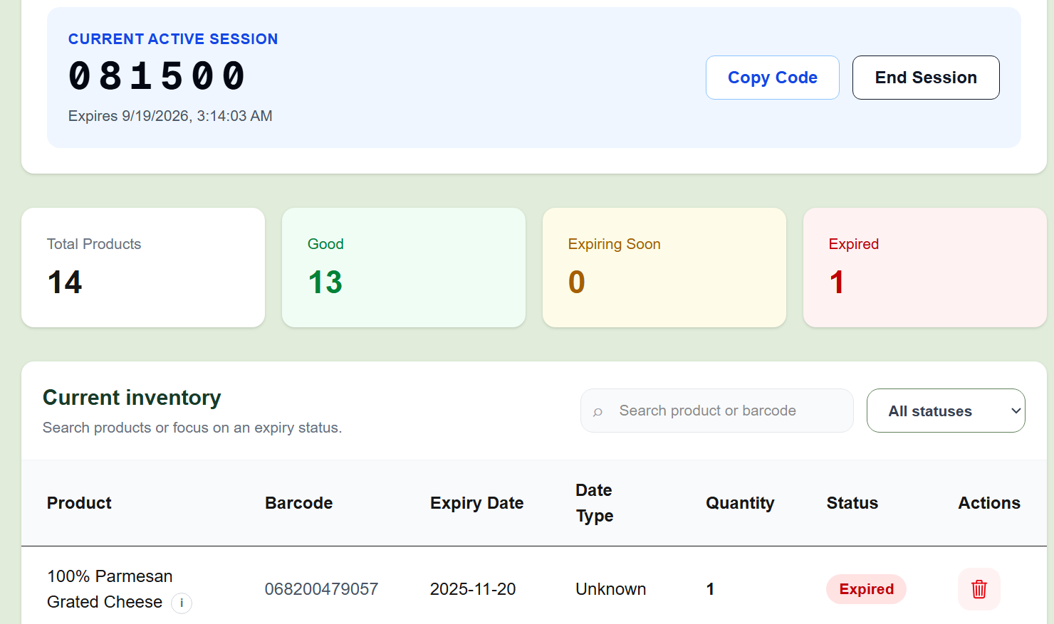
Significance
Particularly in the food bank environment, a comfortable layout and convenient features are essential
Many users will be new workers or volunteers with no prior experience with our product
A smooth design allows for these workers to seamlessly blend into their foodbank workflow without extensive training
User-friendly and welcoming interface

Slide 30
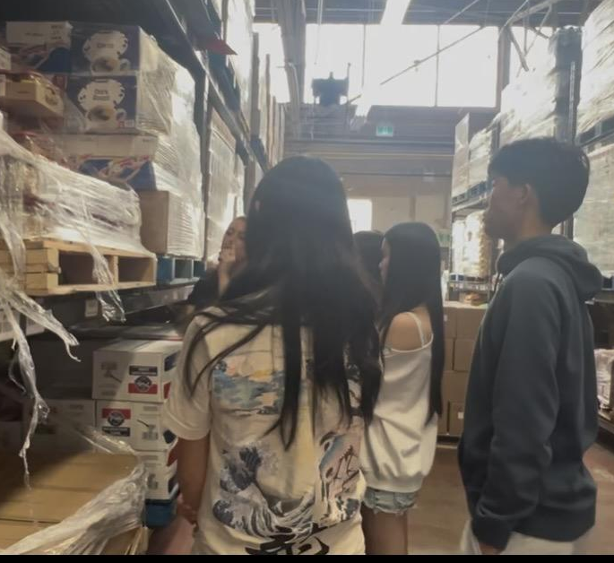
04
Future Developments
Notes:
d

Slide 31
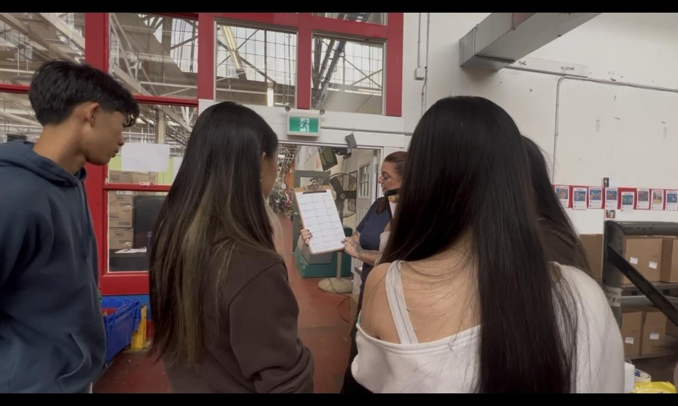
How we will move forward from now:
The Big Picture
Currently, the North York Harvest Food Bank team is moving to a new warehouse
  Employees are very busy, but Judy has been very accommodating and supportive about this project
If communication falls, we will leave it as open project or publish it as a website while featuring the food bank as an appreciated partner
If we are ultimately able to counter systemic obstacles (such as integration alongside Primarius), we may continue to develop the app
Notes:
s

Slide 32
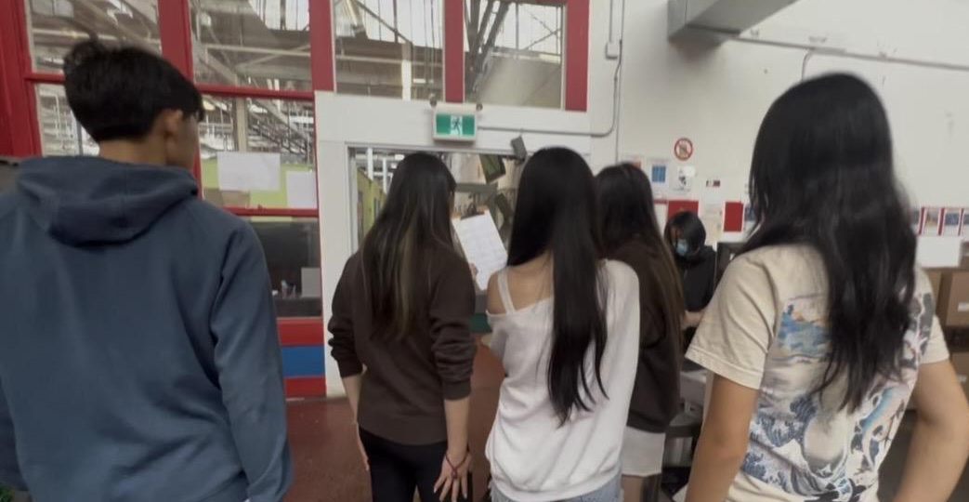
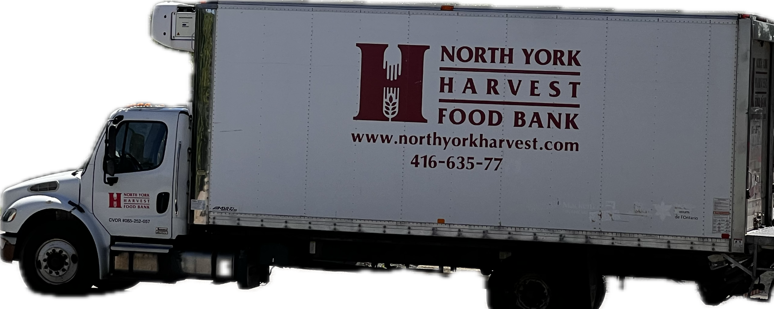
06
Conclusion

Slide 33

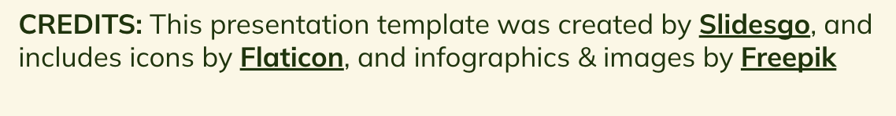
Thanks for listening!
By: Daniel Hou, Sophia Hou, Victoria Xiong, Sarah Du, Jessica Du, and Shauna Lyu

